Slide 1
DOS UNIT-II Communication in Distributed systems
Lecture-2

Slide 2
Asynchronous Transfer Mode (ATM) Networks
Asynchronous Transfer Mode (ATM) is a networking technology designed to provide high-speed, efficient, and reliable data transfer.
It was developed in the late 1980s and early 1990s to address the increasing demands for high-performance networking, especially in environments requiring the transmission of voice, video, and data over a single network.
Basic Concepts:
a. Cell-Based Architecture:
ATM uses a cell-based approach where data is transmitted in fixed-size units called cells.
Each cell is 53 bytes long, consisting of a 5-byte header and a 48-byte payload.
This fixed size helps in simplifying the switching and multiplexing of data.
b. Asynchronous Transmission:
Unlike synchronous transmission, where data is sent in a continuous stream, asynchronous transmission allows cells to be sent independently.
This means that cells can be transmitted without needing to wait for a regular timing signal, which can help in managing variable data rates and reducing delays.

Slide 3
Cont..
2. Key Components:
a. ATM Cells:
Each ATM cell has a fixed length of 53 bytes. The cell header is 5 bytes and contains important information such as:
Virtual Path Identifier (VPI): Identifies the virtual path the cell is on.
Virtual Channel Identifier (VCI): Identifies the virtual channel within the virtual path.
Cell Loss Priority (CLP): Indicates the cell’s priority in case of network congestion.
Header Error Control (HEC): Used for error detection and correction.
b. ATM Switches:
ATM switches are responsible for routing cells from incoming to outgoing links based on the VPI/VCI values.
They perform high-speed, hardware-based switching to ensure minimal latency.

Slide 4
Cont..
c. Virtual Circuits:
ATM supports two types of virtual circuits:
Permanent Virtual Circuit (PVC): A pre-established path that remains in place for ongoing communication.
Switched Virtual Circuit (SVC): A temporary path that is set up on demand and torn down when no longer needed.
3. Traffic Management:
a. Quality of Service (QoS):
ATM is designed to support multiple types of services with different QoS requirements. It provides mechanisms for:
Constant Bit Rate (CBR): Suitable for real-time services like voice and video.
Variable Bit Rate (VBR): Allows for variable data rates, used for bursty traffic like video streaming.

Slide 5
Cont..
Unspecified Bit Rate (UBR): Best-effort service with no guarantees on bandwidth or delay.
Available Bit Rate (ABR): Provides a feedback mechanism to adjust the data rate based on network congestion.
b. Traffic Shaping:
ATM uses traffic shaping techniques to ensure that traffic adheres to specified profiles, preventing network congestion and ensuring efficient utilization of bandwidth.

Slide 6
Cont..
4. Applications:
a. Voice and Video Communication:
ATM was initially developed with a focus on multimedia communication.
Its ability to handle real-time data with predictable QoS made it suitable for voice and video applications.
b. High-Speed Data Transfer:
ATM provides high-speed data transfer capabilities, making it useful for data-intensive applications and environments requiring fast and reliable network connections.
c. Backbone Networks:
ATM is often used in backbone networks of telecommunications providers due to its high performance and ability to handle diverse traffic types.

Slide 7
Cont..
ATM working principle:
Sender first establishes a connection (virtual circuit) to the receiver(s)
A route is determined from sender to receiver
Routing information is stored in the switches along the way
Packets can be sent through this connection by sender
Packets are chopped into small fixed-sized units (cell) by hardware
Routing information purged from switches when connection is not required
ATM Advantages:
A single network is used to transport voice, data, broadcast television, videotapes, radio.
It is used for video conferencing, video-on-demand, teleconferencing, access to thousands of remote databases
Cost saving
ATM uses cell switching which handles both point-to-point and multicasting efficiently
ATM allows rapid switching as its cell (or packet) size is fixed

Slide 8
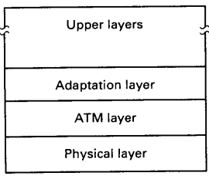
ATM Layers
The ATM reference model

Slide 9
Cont..
The Physical Layer:
The Physical Layer is responsible for the actual transmission of ATM cells over the physical medium.
It deals with the hardware aspects of data transmission.
a. Functions:
Transmission and Reception: Handles the physical transmission of ATM cells over various types of media, such as optical fibers, copper cables, or wireless links.
Encoding and Decoding: Performs encoding and decoding of data to convert it into a format suitable for transmission.
b. Components:
Physical Medium: The actual hardware that carries the data, such as fiber optics or copper cables.
Transceivers: Devices that convert electrical signals to optical signals and vice versa.

Slide 10
Cont..
An ATM adaptor board plugged into a computer can put out a stream of cells onto a wire or fibre.
The transmission stream must be continuous.
Alternatively, the adapter board can use SONET (Synchronous Optical Network) in the physical layer, putting its cells into the payload portion of SONET frames.
In SONET, the basic unit is a 9 X 90 array of bytes called a frame.
Out of these 810 bytes, 36 bytes are overhead, leaving 774 bits of payload.
One frame is transmitted every 125 microsecond to match the telephone system’s standard sampling rate of 8000 samples per second, so the gross data rate (including overhead) is 51.840 Mbps and the net data rate (excluding overhead) is 49.536 Mbps.
Basic 51.840 Mbps channel is called OC-1.
It is possible to send a group of n OC-1 frames as a group, which is designated as OC-n.
OC-12 and OC-48 are used for long-haul transmission.

Slide 11
Cont..
The ATM Layer:
The ATM Layer is responsible for cell-based switching and routing. It operates above the Physical Layer and is fundamental to the operation of ATM networks.
a. Functions:
Cell Switching and Routing: The ATM Layer is responsible for the forwarding of fixed-size cells between network nodes based on the Virtual Path Identifier (VPI) and Virtual Channel Identifier (VCI).
Cell Header Processing: The layer reads and processes the ATM cell header, which contains routing information such as VPI/VCI, Cell Loss Priority (CLP), and Header Error Control (HEC).
b. Key Components:
Virtual Paths and Channels: Data is routed through Virtual Paths (VPs) and Virtual Channels (VCs). A VP is a bundle of VCs, and a VC is a logical connection between two endpoints.
Switching: ATM switches handle the switching of cells based on the VPI/VCI values in the cell header.

Slide 12
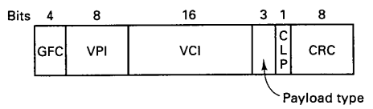
Cont..
The layout of a cell header from a computer to the first ATM switch is shown in figure below:
The Generic Flow Control (GFC) field is used for the flow control purpose.
The VCI and VPI fields together identify which path and virtual circuit a cell belongs to.
Routing tables along the way use this information for routing.
These fields are modified at each hop along the path.
The purpose of the VPI field is to group together a collection of virtual circuits for the same destination and make it possible for a carrier to reroute all of them without having to examine the VCI field.
The payload type field distinguishes data cells from control cells and further identifies several kinds of control cells.
The CLP field can be used to make some cells less important than others, so if congestion occurs the least important ones will be the ones dropped.

Slide 13
Cont..
ATM Adaptation Layer (AAL):
The ATM Adaptation Layer (AAL) provides the necessary functionality to adapt user data to the cell-based ATM Layer.
It ensures that the data is correctly formatted and reassembled at the destination.
a. Functions:
Segmentation and Reassembly (SAR): AAL segments higher-layer data into ATM cells for transmission and reassembles cells back into data at the receiving end.
Error Detection and Correction: AAL includes mechanisms for error detection and correction to ensure reliable data transfer.
b. AAL Types:
There are several AAL types, each designed for different types of services:
AAL1: Designed for Constant Bit Rate (CBR) services like voice and video. It provides timing recovery and is used for synchronous services.

Slide 14
Cont..
AAL2: Used for Variable Bit Rate (VBR) services, such as compressed voice. It provides support for variable-length data and multiplexing.
AAL3/4: Intended for connection-oriented and connectionless data services. AAL3/4 is suitable for applications requiring reliable delivery with error correction.
AAL5: The most commonly used AAL type for data applications, providing efficient data transport with minimal overhead. It is used for connectionless services like IP over ATM.
Adaptation Layer has four classes:
Constant bit rate traffic (for audio and video)
Variable bit rate traffic but with bounded delay
Connection-oriented data traffic
Connectionless data traffic

Slide 15
Cont..
Simple and Efficient Adaptation Layer (SEAL):
1 bit of ATM header, 1 bit of Payload Type
Payload Type field is set to 1 for last cell, otherwise 0
Last cell contains 8 bytes trailer with four fields
Trailer contains packet length (2 bytes), checksum (4 bytes)
ATM Switching:
ATM networks are built up of copper or optical cables and switches.
Figure in the next slide illustrates a network with four switches.
Cells originating at any of the eight computers attached to the system can be switched to any of the other computers by traversing one or more switches.
Each of these switches has four ports, each used for both input and output.

Slide 16
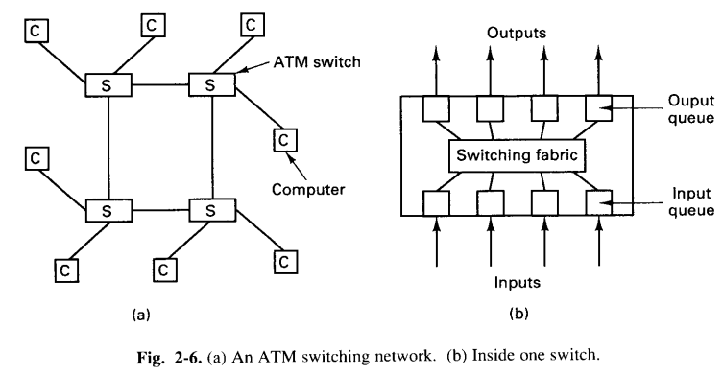
Cont..

Slide 17
Cont..
The inside of a generic switch is also shown in the figure in the previous slide.
It has input lines and output lines and a parallel switching fabric that connects them.
When a cell arrives, its VPI and VCI fields are examined.
Based on these and the information stored in switch, the virtual circuit was established and the cell is routed to the correct output port.
A problem arises when two cells arrive at the same time on different input lines and need to go to the same output port.
Dropping one of them away is allowed by the standard, but if your switch drops more than 1 cell in 10¹², the efficiency of the ATM network drops significantly. This problem is known as head-of-line blocking.
Solution: Keep copy of a cell in a output buffer queue.

Slide 18
Cont..
ATM Implications for Distributed Systems:
High-speed network but latency remains high.
Flow control.
Transcontinental Delay.
Cell drops during congetion.

Slide 19
Homework Questions
State advantages of ATM over traditional switching technology.
Describe head-of-line blocking problem in ATM switching network. What can be the possible solution?
What is the probability that a totally garbled ATM header will be accepted as being correct?
An ATM system is transmitting cells at the OC-3 rate. Each packet is 48 bytes long, and thus fits into cell. An interrupt takes 1 microsecond. What fraction of the CPU is devoted to interrupt handling? Now repeat this problem for 1024-byte packet.

